Slide 1
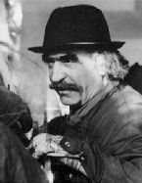
DOV Muzische Vorming 2 Muzisch project
Jean Tinguely

Slide 2
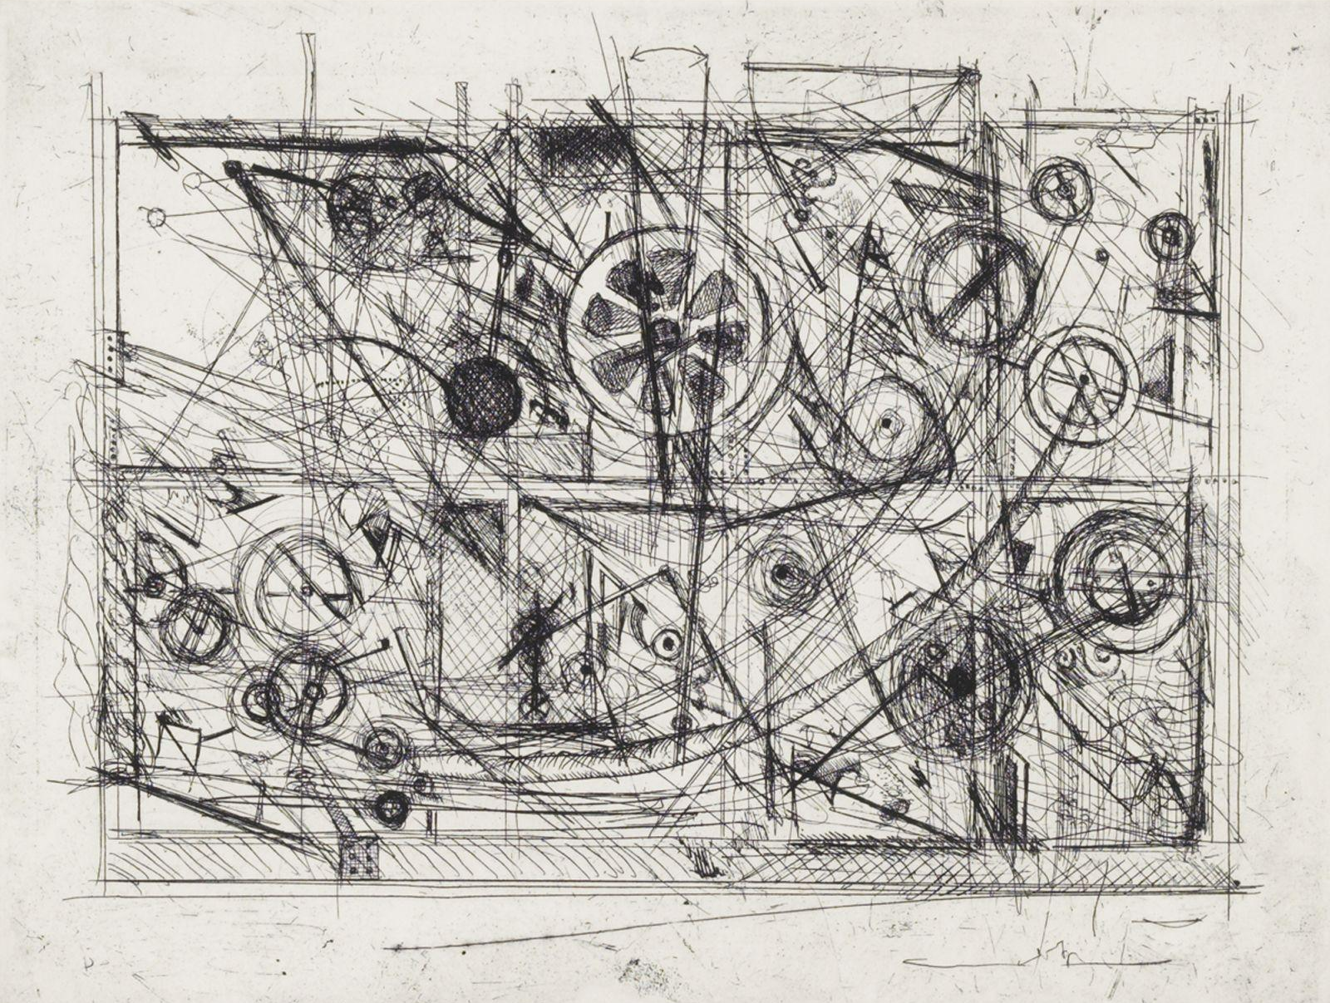
Onbekend, ‘60

Slide 3
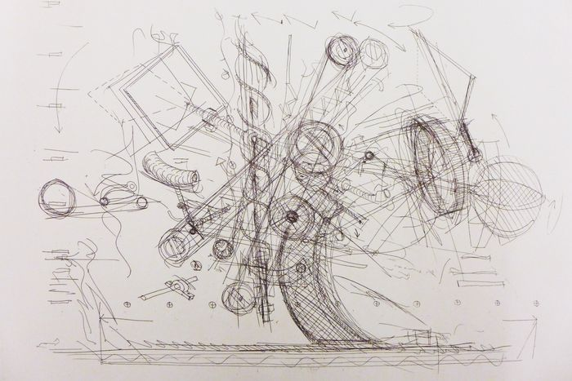
Chaos, ‘72

Slide 4
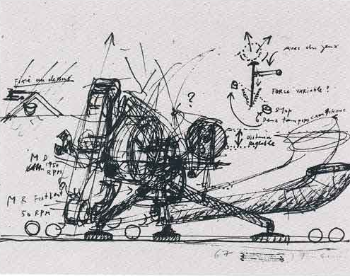
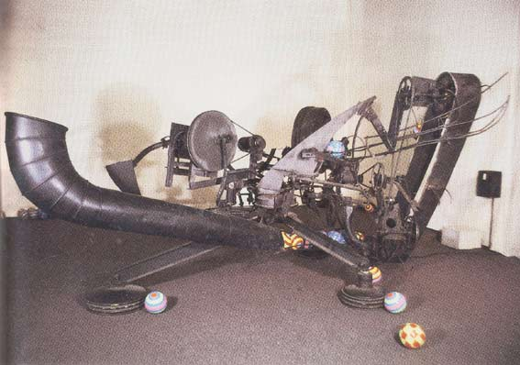
Rotozaza I, ‘67

Slide 5
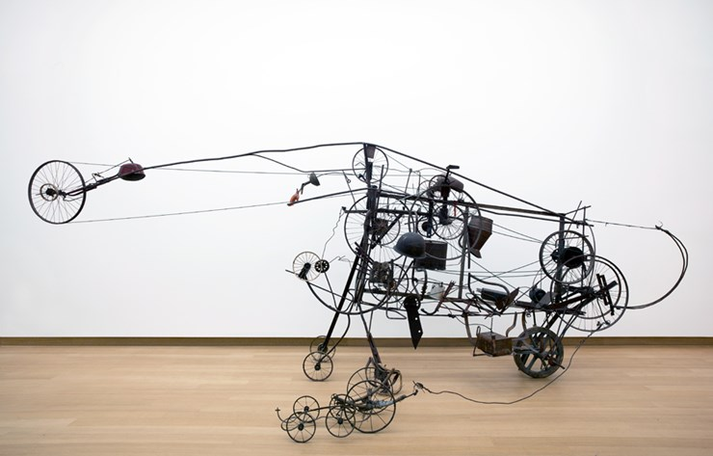
Gizmo, ‘60

Slide 6
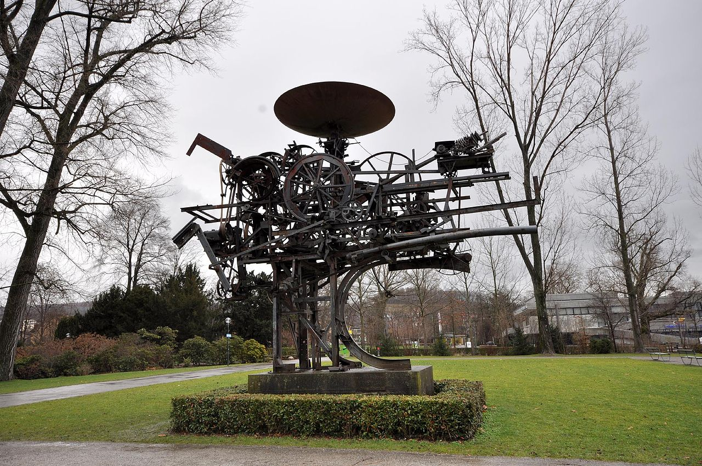
Heureka, ‘64

Slide 7
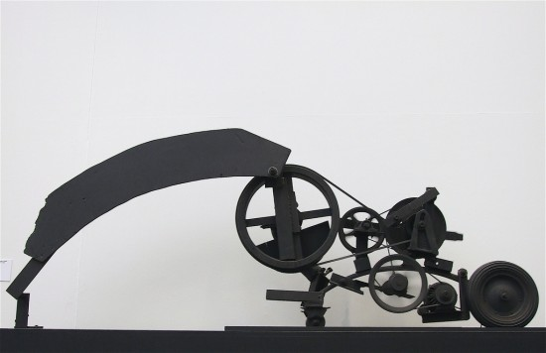
Char, ‘66-’67

Slide 8
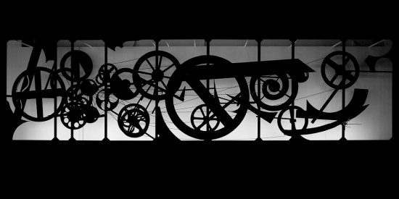
Requiem pour une feuille morte, ‘67

Slide 9
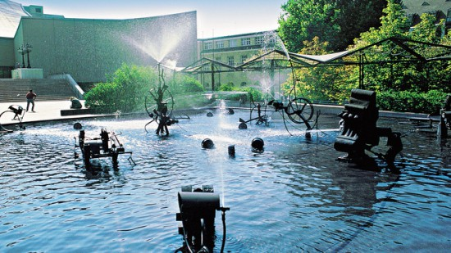
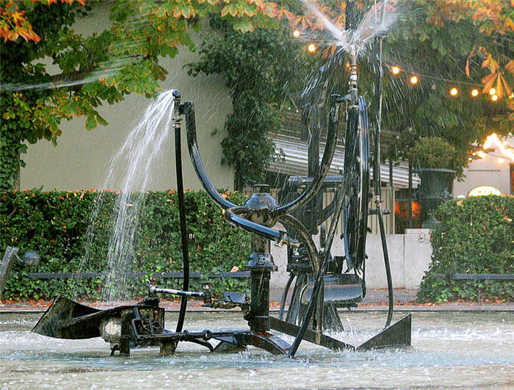
Tinguely-fontein, ‘77

Slide 10
Narva, ‘61
0:15
https://www.youtube.com/watch?v=aISUeow1JIQ

Slide 11
Onbekend
0:10
https://www.youtube.com/watch?v=AVAM-6GbAsg

Slide 12
Stravinsky-fontein, ‘83
4:32
https://www.youtube.com/watch?v=atOaHRZBiJM

Slide 13
Enkele jaren later ….

Slide 14
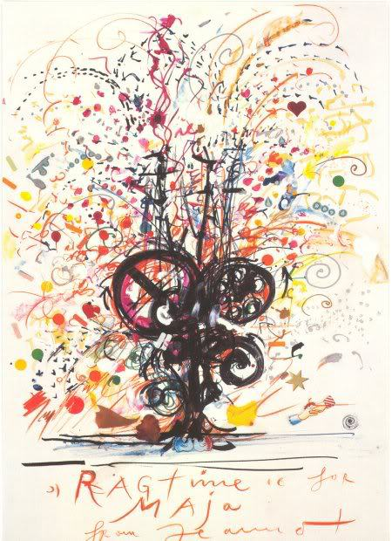
Ragtime for Maja, ‘83

Slide 15
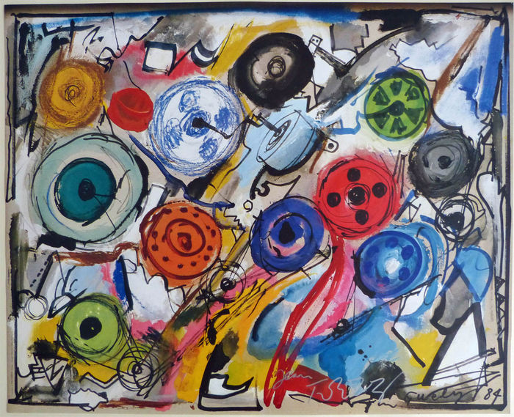
Palazzo Grassi, ‘84

Slide 16
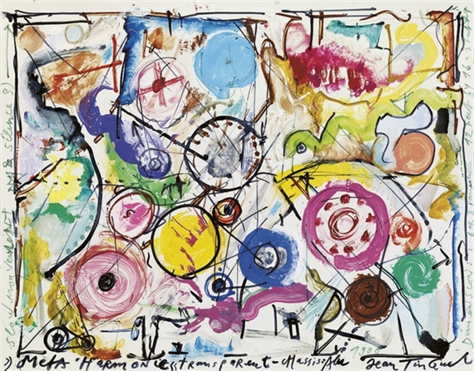
Méta-Harmonie II, ‘90

Slide 17
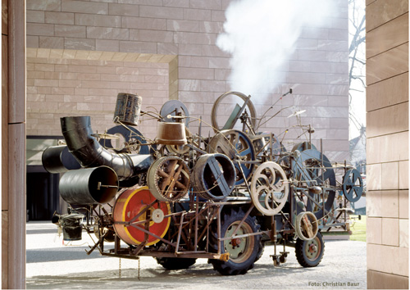
Klamauk, ‘79

Slide 18
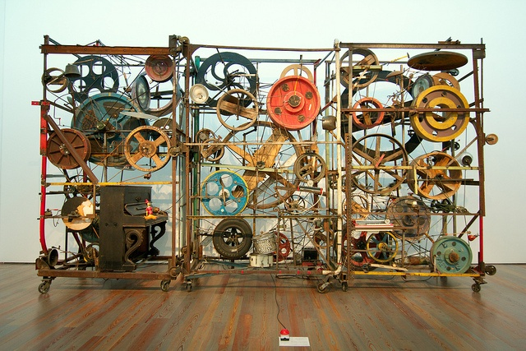
Méta-Harmonie II, ‘79

Slide 19
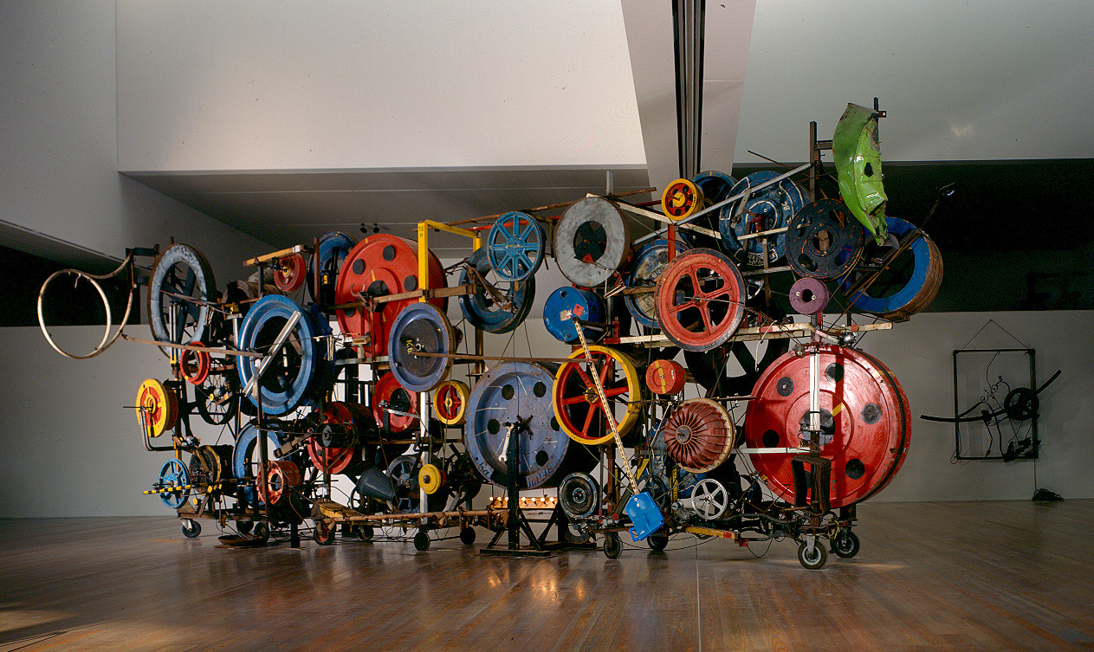
Fatamorgana (Méta-Harmonie VI), ‘85

Slide 20
Méta-Harmonie II, ‘79
0:21
https://www.youtube.com/watch?v=Di1sYVtm46A

Slide 21
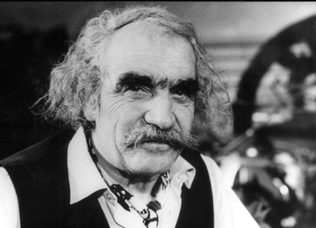
Jean (Charles) Tinguely
1925 – † 1991

